Slide 1
Building and Evaluating Machine Learning Models
Cornellius Yudha Wijaya

Slide 2

Biography
Cornellius Yudha Wijaya
7+ years of experience in the Data Science field, with a professional background in the financial industry (Allianz) and the Tech Industry (Arif).
Actively writing data content with 42k+ followers on LinkedIn (Top Voice), 9400 Newsletter subscribers, and 600+ articles written.
Expertise in Data Science Implementation, AI System development, and Data Content Creation.

Slide 3
Content
Introduction to Machine Learning
Data Preparation
Model Training Fundamentals
Evaluating Models
Model Tuning & Improvements
Best Practices for Robust Models

Slide 4
Introduction to Machine Learning
“Learning is any process by which a system improves performance from experience.”
- Herbert Simon
Why “Learn” ?
Machine learning is programming computers to optimize performance criteria using example data or experience.
Learning is used when:
Human expertise does not exist (COVID-19 pandemic),
Humans are unable to explain their expertise (medical diagnosis)
Solution changes in time (routing on a computer network)
Solution needs to be adapted to particular cases (user biometrics)

Slide 5
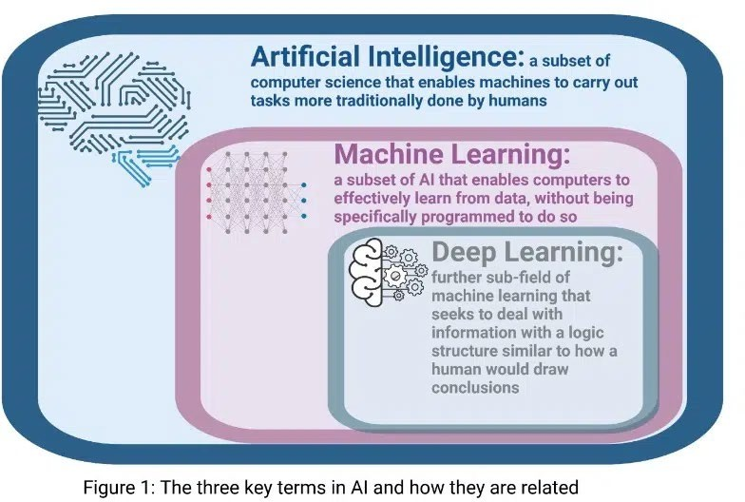
Machine Learning Position in AI

Slide 6
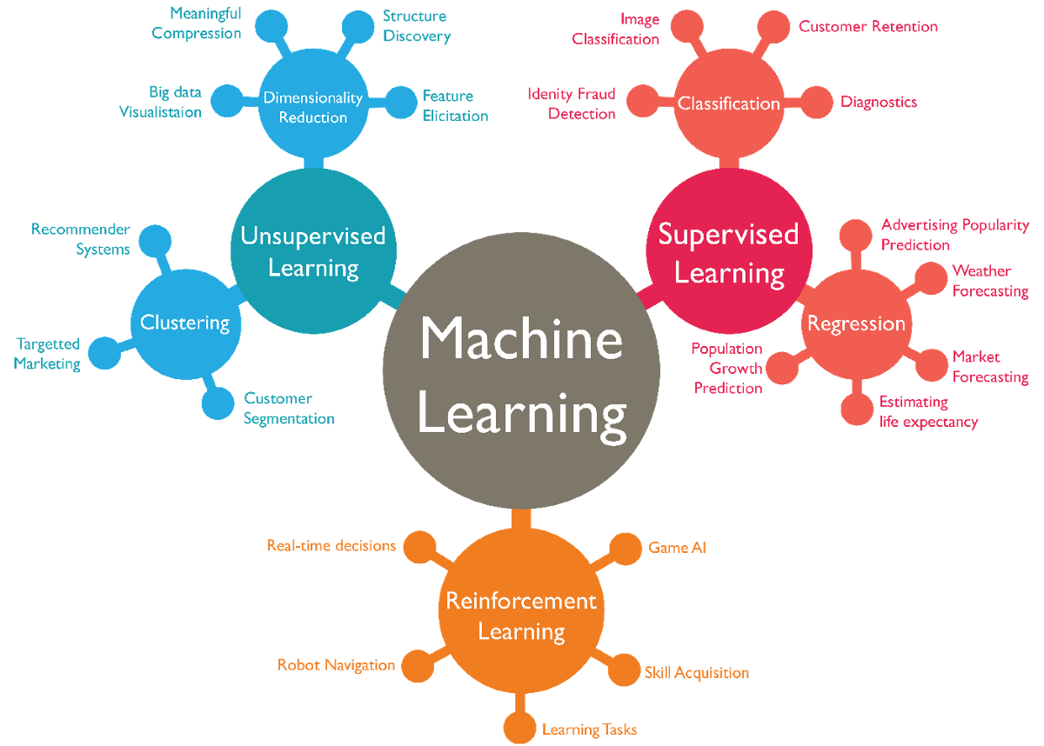
Types of Machine Learning

Slide 7
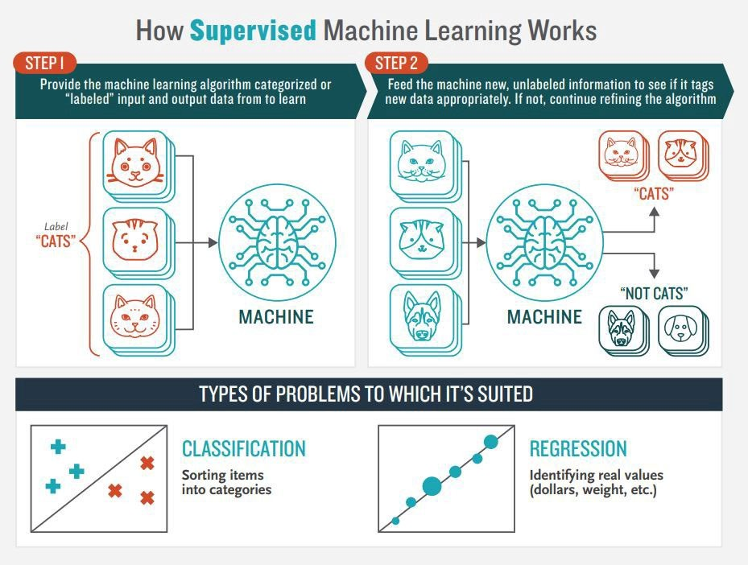

Slide 8
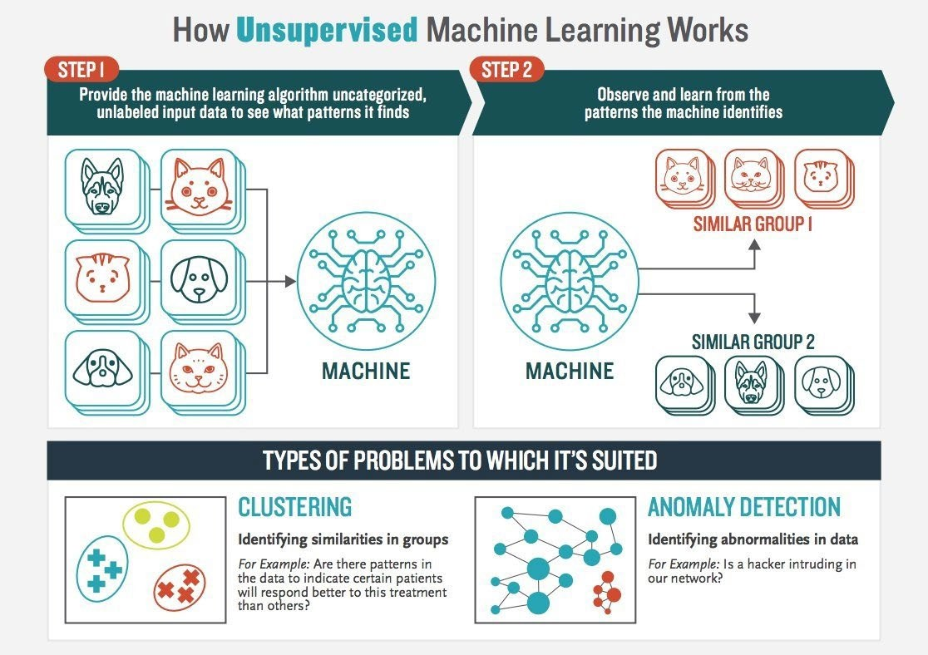

Slide 9









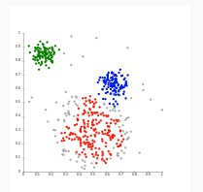

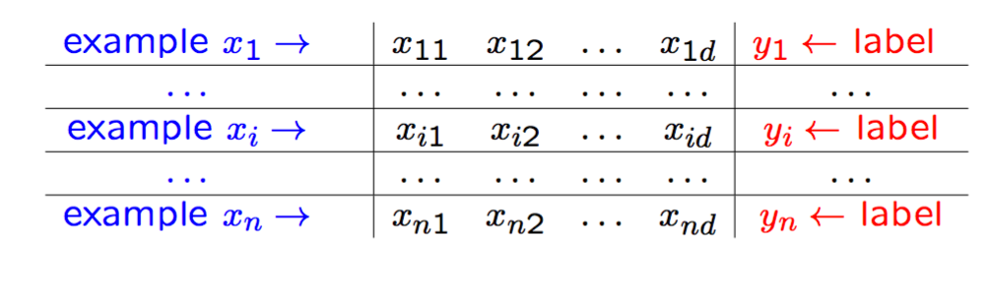



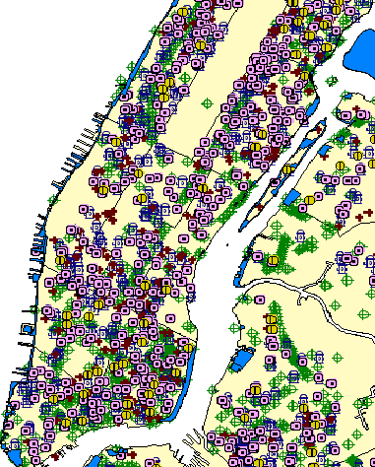
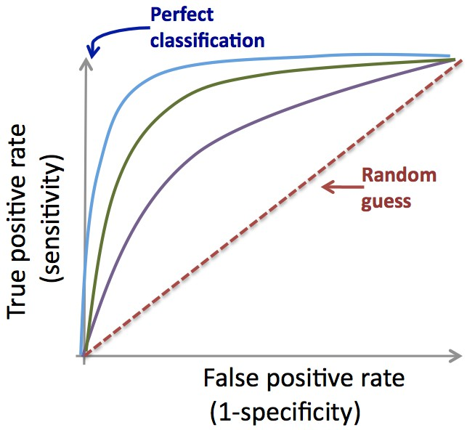





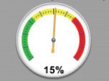

Data Science Process
1
DATA COLLECTION
2
DATA PREPARATION
3
EDA
Static Data.
Data cleaning
Descriptive statistics, Clustering Research questions?
A and B → C
DB
Static
Data.
Feature/variable engineering
Domain expertise
Time
5
Visualization
4 MACHINE LEARNING
Application deployment
Classification, scoring, predictive models, clustering, density estimation, etc.
+
+
-
+
+
-
-
+
+
-
-
+
+
-
Data-driven decisions
Model (f)
-
Predicted class/risk
Yes /
Dashboard
90%

Slide 10
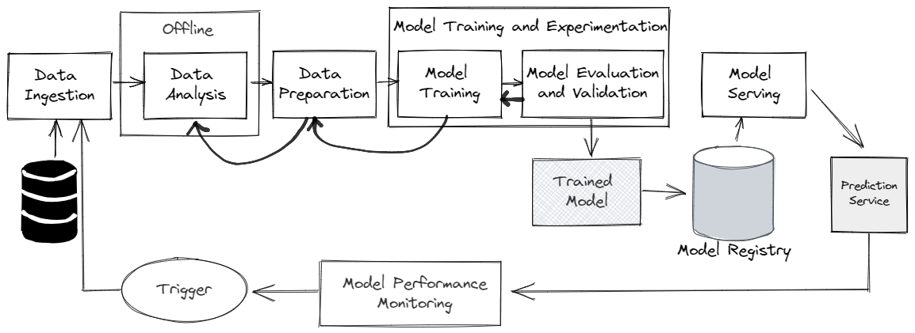
Machine Learning Workflow

Slide 11
Data Preparation
Why clean data matters
Feature selection
Data Preprocessing
Data Splitting
K-Fold Cross Validation

Slide 12
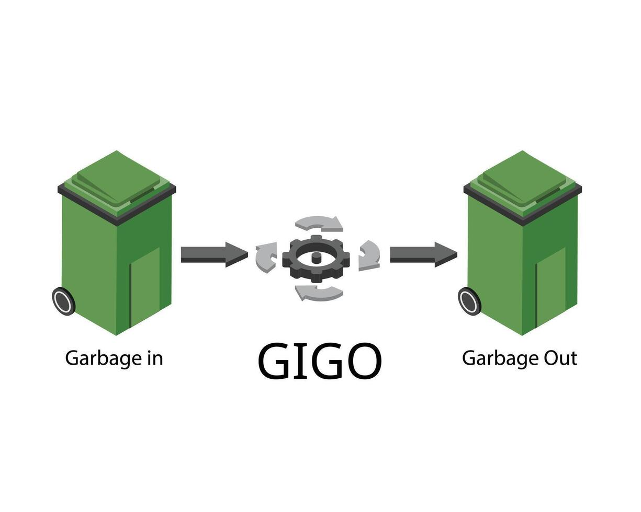
Why Clean Data Matter
Clean data ensure:
Accuracy depends on input quality
Reduces noise & bias
Saves time in model training
Builds trust in predictions

Slide 13
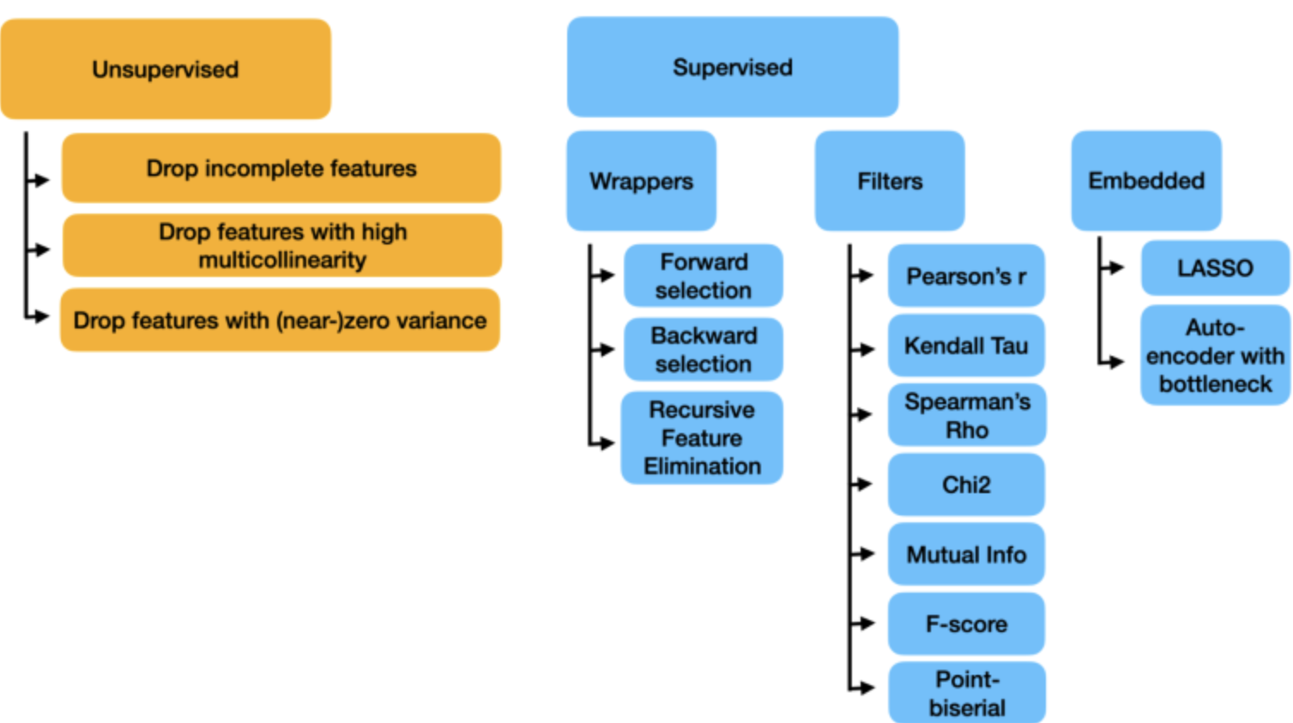
Feature Selection
Feature Selection is a a process to select informative features and remove the rest.

Slide 14
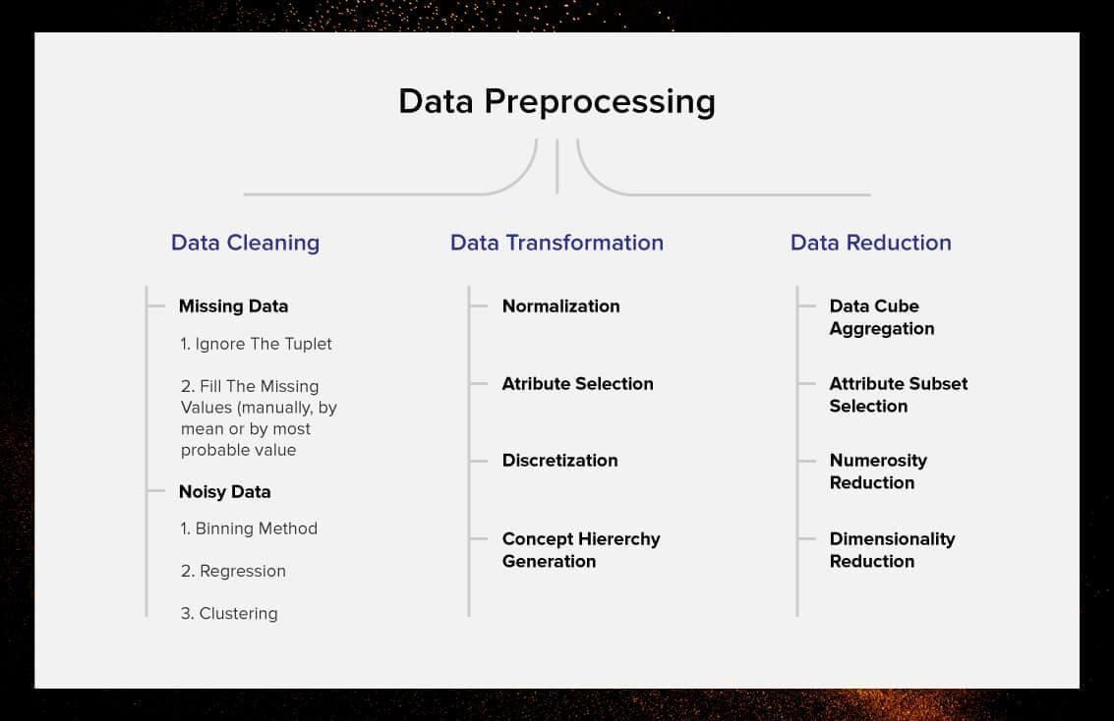
Data Preprocessing
Data preprocessing turns raw data into a form that appropriate for the model implementation.

Slide 15
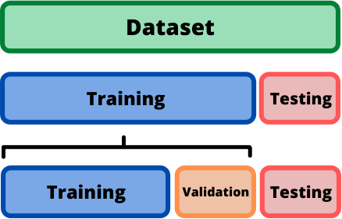
Data Splitting
To build and evaluate the performance of a machine learning model, we usually break our dataset into two distinct datasets. These two datasets are the training data and test data.

Slide 16
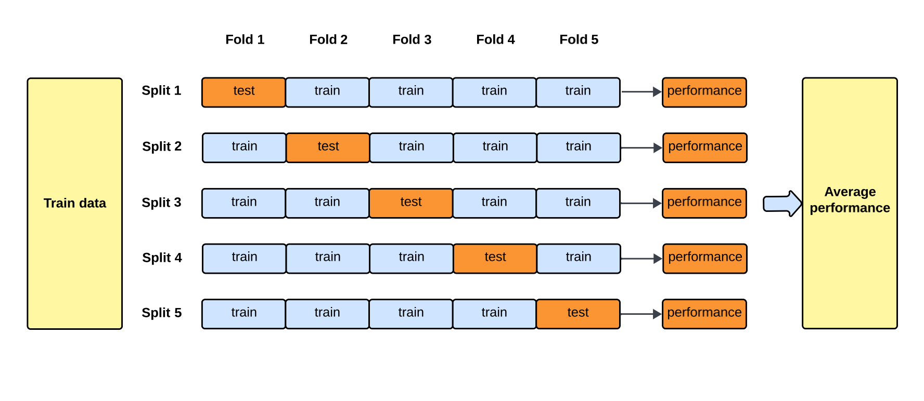
K-Fold Cross Validation
In the case when our dataset is small, using just one train–test split can give unreliable performance estimates because results may vary depending on how the data was split.
This is where K-fold cross-validation helps better estimate by splitting the data

Slide 17
Model Training Fundamentals
Concept of Model fitting
Machine Learning Model Error
Bias vs variance trade-off (underfitting vs overfitting)
Common baseline models

Slide 18
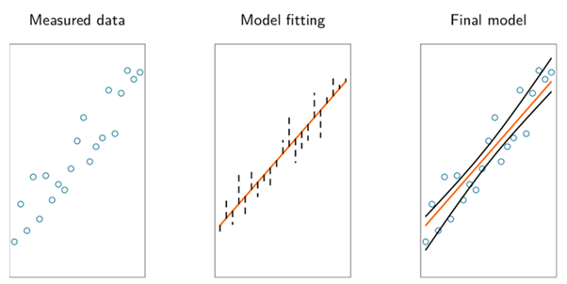
Concept of Fitting
When we say a model fits the data, we mean it learns patterns from examples.
Example:
Linear regression calculates coefficients directly to minimize squared error with a straight line.
However, errors will always be present during fitting.

Slide 19
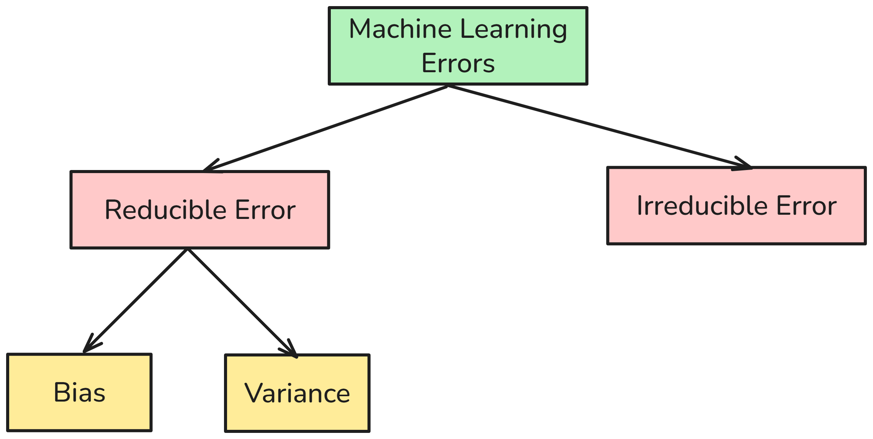
Machine Learning Errors
There are two main types of errors present in any machine learning model:
Reducible Errors
Irreducible Errors
We can further divide reducible errors into two:
Bias
Variance

Slide 20
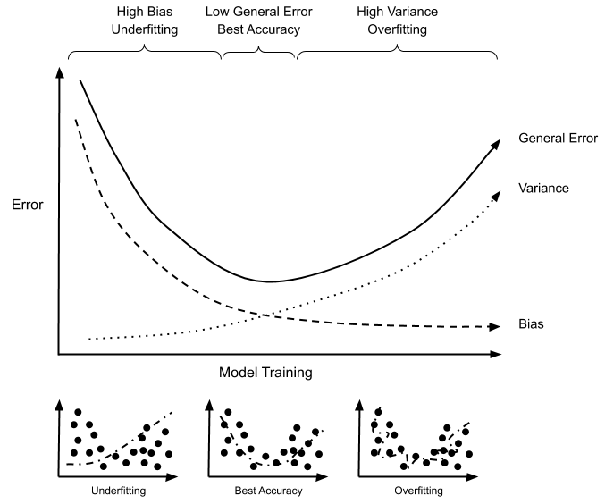
Bias vs variance trade-off (underfitting vs overfitting)
Model fitting has limits.
If the model is too simple, it underfits, which means the model misses patterns.
If it’s too complex, it overfits which, means the model memorizes noise instead of generalizing.
Good fitting means finding the sweet spot between underfit and overfit.

Slide 21
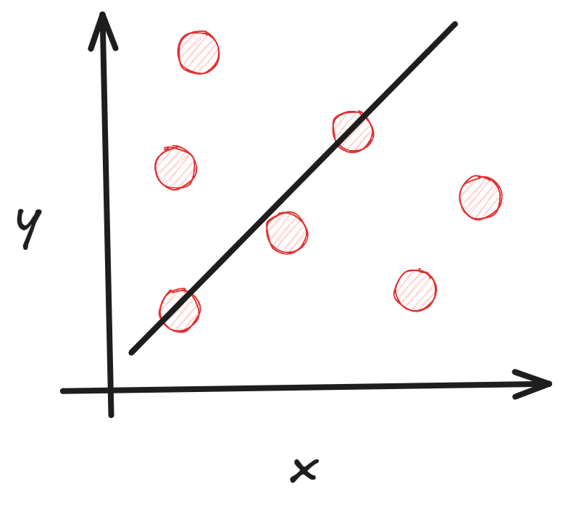
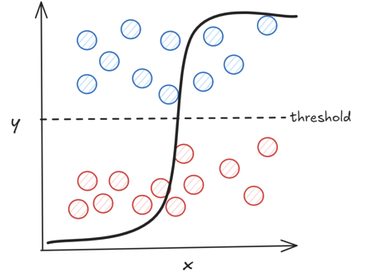
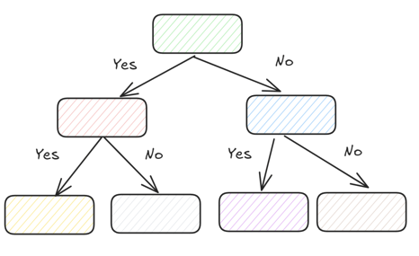
Common baseline models
Before jumping into advanced algorithms like ensembles or deep learning, it’s important to start with baseline models.
These give us a reference point, which is a simple, interpretable model that helps us understand whether more complexity is worth it.
Linear Regression
Logistic Regression
Decision Tree

Slide 22
Evaluating Models
Why evaluation is critical
Metrics for regression
Metrics for classification
Business vs technical evaluation

Slide 23
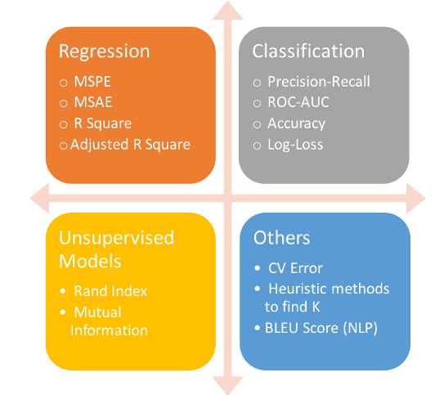
Why evaluation is critical
Evaluation is an essential step in any machine learning model development, as it allows us to assess whether the models we use are usable or require further improvement.
Evaluation does three things:
Checks generalization: does the model work on new, unseen data?
Detects overfitting & bias: is the model memorizing noise or missing subgroups?
Connects to business value: a model that’s 95% accurate but misclassifies the 5% most important cases (like fraud or churn) might not be good enough.

Slide 24
Metrics for regression
MAE (Mean Absolute Error): Average of absolute prediction errors in the target’s units, treats all errors equally, and is robust to outliers.
MSE (Mean Squared Error): Average of squared errors, penalizes large mistakes more heavily but is less intuitive due to squared units.
RMSE (Root Mean Squared Error): The square root of MSE keeps sensitivity to large errors yet returns to target units for easier interpretation, compared with MAE, to gauge error spread.
R² Score: Proportion of variance in the target explained by the model, typically between 0 and 1, can be negative if worse than predicting the mean.
Adjusted R²: R² corrected for the number of predictors, increases only when added features improve explanatory power after accounting for model size.

Slide 25
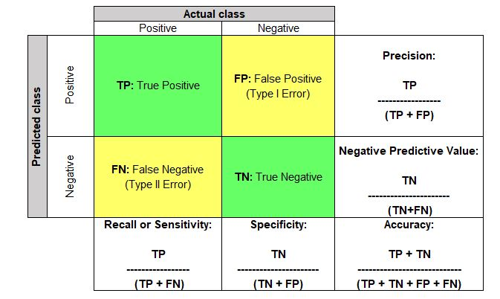
Metrics for classification
Accuracy: Proportion of all predictions that are correct, useful with balanced classes and symmetric error costs.
Precision (Positive Predictive Value): Of predicted positives, the fraction that are truly positive, prioritize when false positives are costly.
Recall (Sensitivity, TPR): Of actual positives, the fraction correctly identified, prioritize when false negatives are costly.
Specificity (TNR): Of actual negatives, the fraction correctly rejected, complements recall.
F1 Score: Harmonic mean of precision and recall, a single balance point when both error types matter and classes are imbalanced.

Slide 26
Model Tuning & Improvement
Hyperparameters vs parameters
Hyperparameters Optimization
Grid Search & Random Search
Ensemble methods

Slide 27
Parameters vs Hyperparameters
Internal values learned automatically from the data during training, such as weights in linear regression or node splits in a tree.
Parameters
External settings defined before training that guide how the model learns, such as learning rate, tree depth, or number of clusters.
Hyperparameters

Slide 28
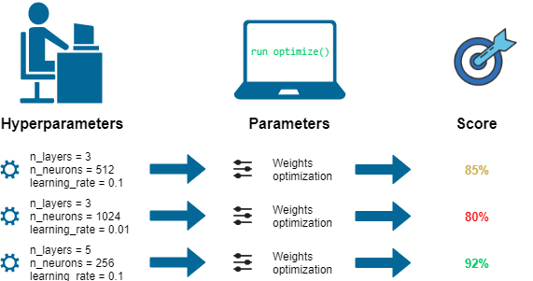
Hyperparameter Optimization
Hyperparameter optimization is the process of systematically choosing the settings that govern how a model learns, such as learning rate, regularization strength, tree depth, or kernel parameters, to maximize performance on unseen data.

Slide 29
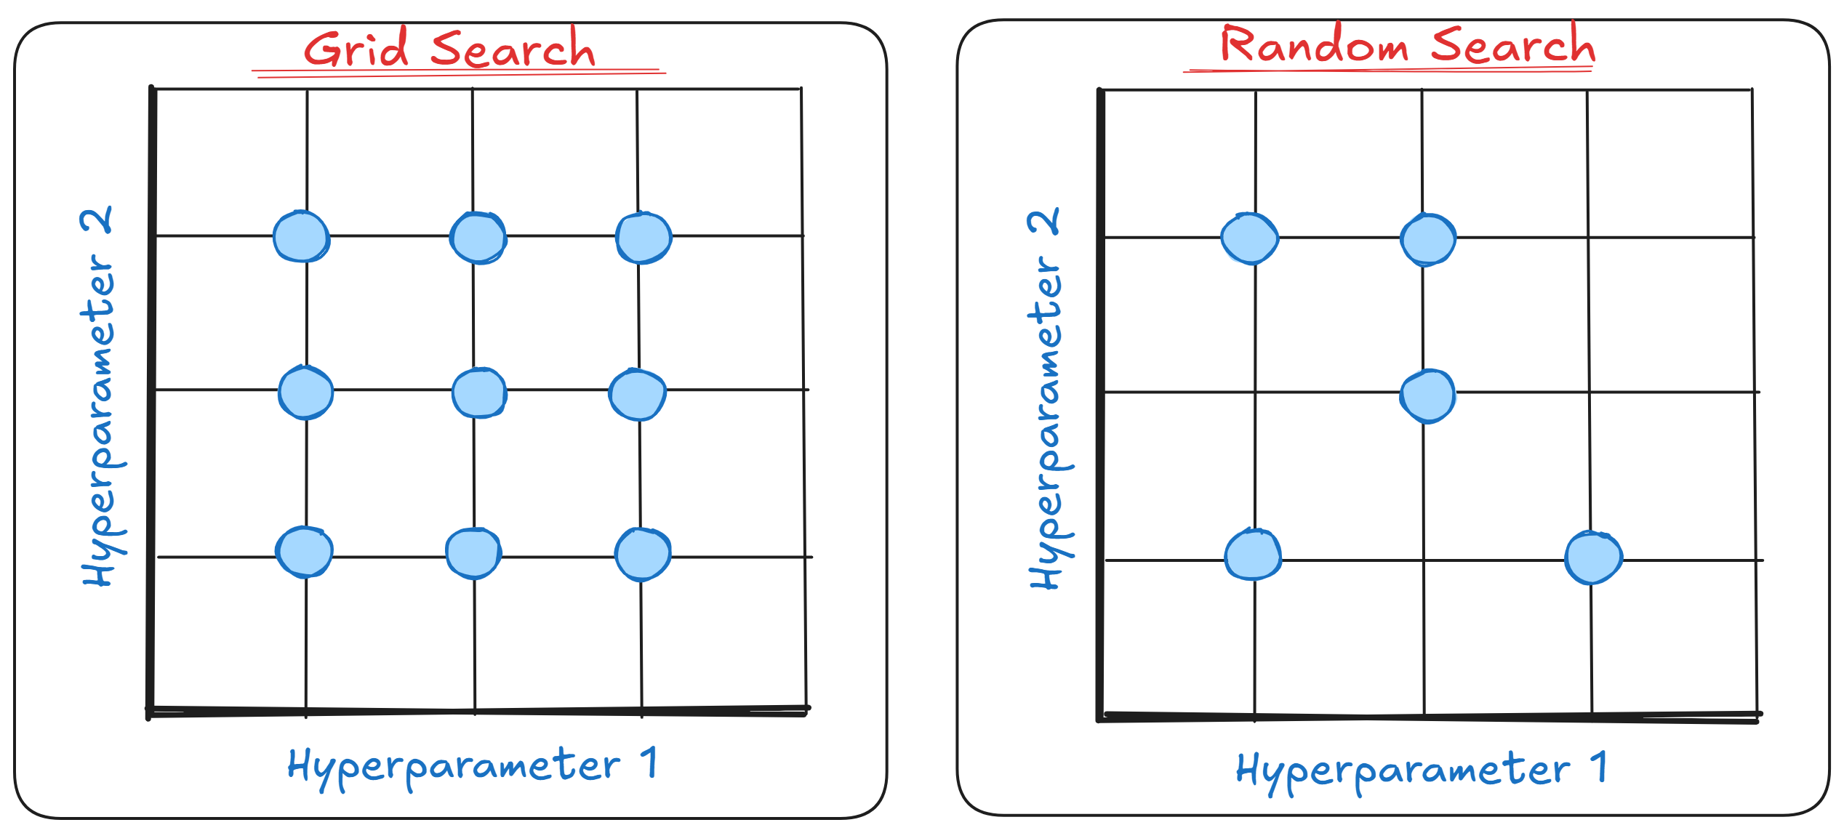
Grid Search & Random Search
Evaluates every combination from a predefined hyperparameter grid to find the configuration that maximizes a chosen validation metric.
Sample hyperparameter combinations from specified distributions instead try all combinations.

Slide 30
Ensemble methods
The ensemble method is a machine learning technique that combines multiple "base" models to become a single yet stronger model. This methodology's idea is that different models make different errors, but by aggregating them, we can reduce the error and achieve better generalization than a single model.
In general, there are two prominent ensemble families:
Bagging: A method that trains many models in parallel with resampled data and aggregates their outputs.
Boosting: A method that builds models sequentially; each new learner focuses on the previous error and aims to yield a better model.

Slide 31
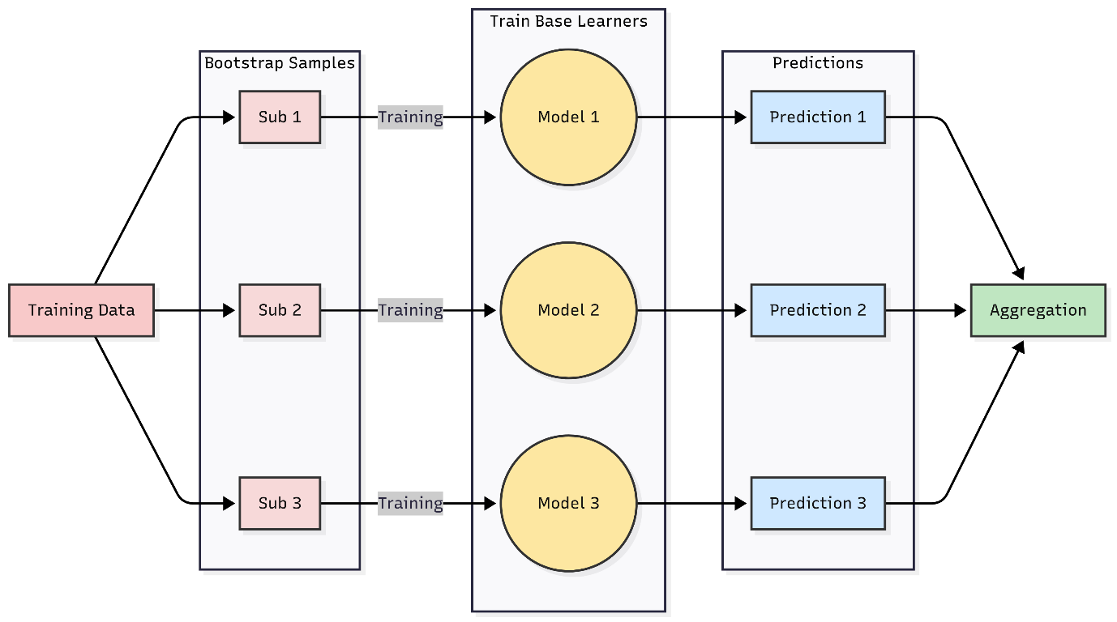
Ensemble Method: Bagging
Bagging or Bootstrap Aggregating is an ensemble method that trains many copies of the same base model on different versions of the training data and aggregates their predictions.

Slide 32
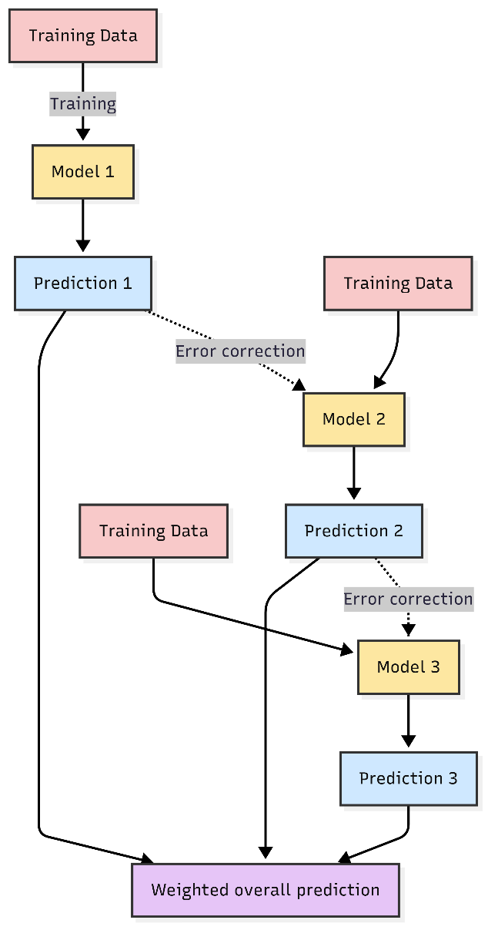
Ensemble Method: Boosting
Boosting is an ensemble method that trains a sequence of simple or weak models. Each new model focuses on the errors of the previous models. The ensemble aggregates each model's contributions to produce the final prediction.

Slide 33
Best Practices for Robust Models
Avoiding data leakage
Interpreting models responsibly
Documenting experiments
Iterative improvement cycle

Slide 34
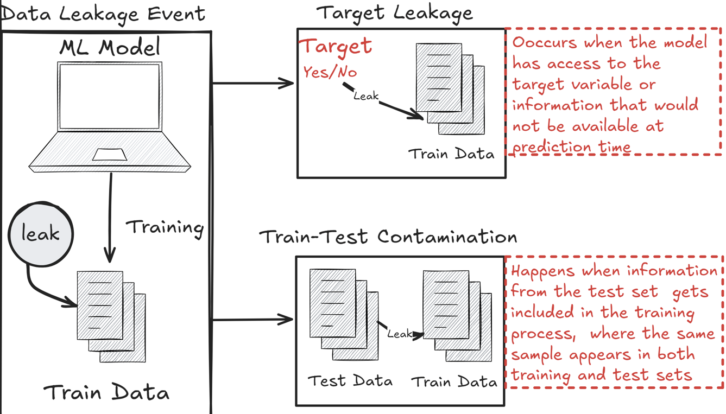
Avoiding data leakage
Data leakage occurs when information from outside the training dataset sneaks into the model and inflates performance unrealistically.

Slide 35
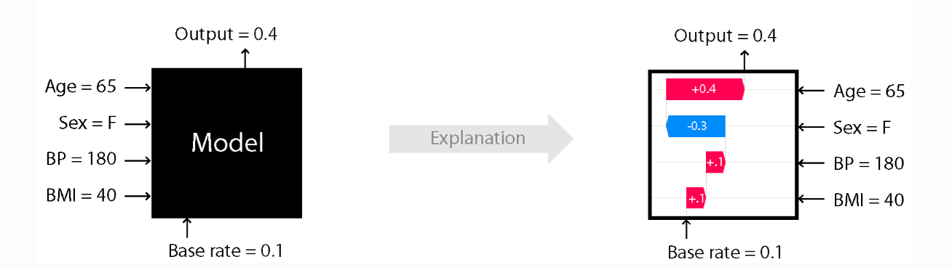
Interpreting Models Responsibly
Interpreting models responsibly means explaining what the model has learned, how it arrives at decisions, and where it may fail, while preserving accuracy, privacy, and fairness.

Slide 36
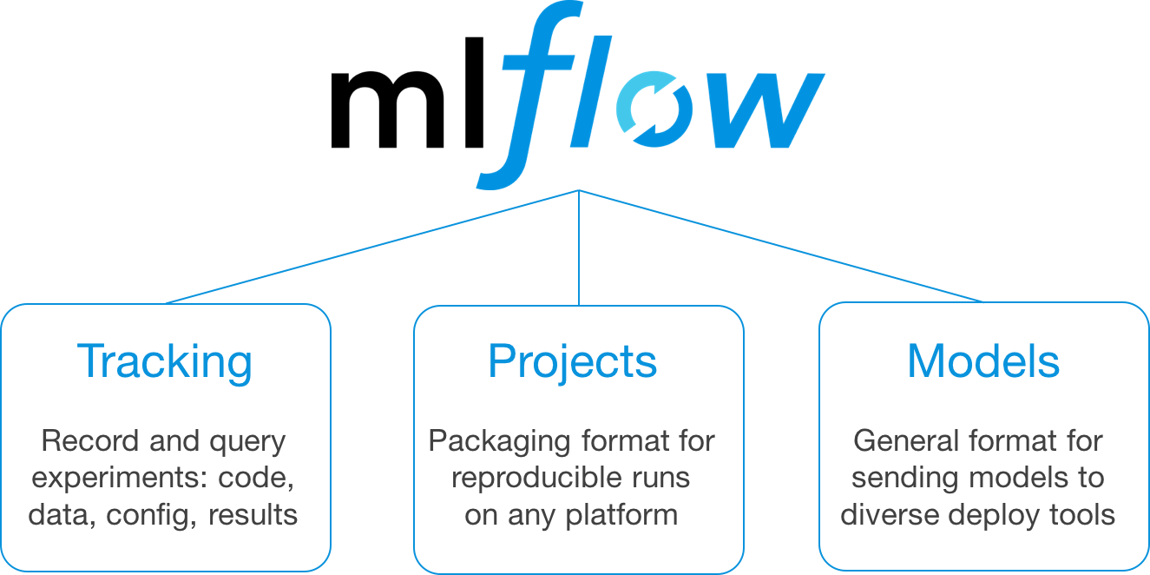
Documenting experiments
Documenting experiments creates a reproducible, auditable record of what was tried, why it was tried, and what was learned. Proper documentation links hypotheses, datasets, code, configurations, metrics, and artifacts so that results can be verified, compared, and deployed with confidence.

Slide 37
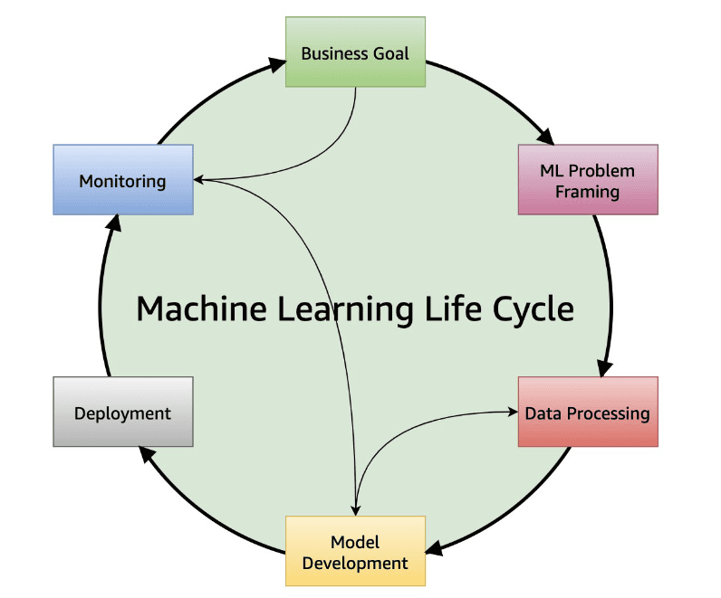
Iterative improvement cycle
The iterative improvement cycle is the structured process of refining models through repeated experimentation, evaluation, and adjustment until they reach acceptable performance for deployment.
Rather than expecting a single training run to yield an optimal model, data scientists adopt a cycle of hypothesis, testing, and revision that mirrors the scientific method.

Slide 38
DEMO

Slide 39




LinkedIn: Cornellius Yudha Wijaya
Medium: @cornelliusyudhawijaya
Newsletter: nb-data.com

